Slide 1
Review: What are the questions to ask when naming?
Instructions: Depending on your comfort level with naming and forming compounds already and your recall of polyatomics from grade 10, you can choose to watch the video on the next slide (best to complete this if you are not as confident) or skip straight to the written review grade 10 content and extending to the grade 11. This primarily involves understanding the variants of the “-ate” polyatomics.

Slide 2
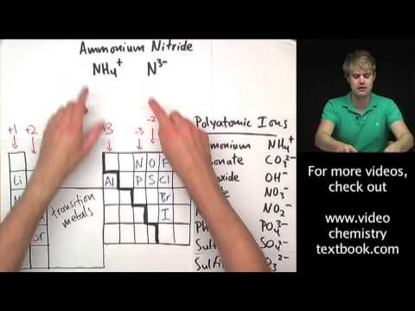
Video version OR skip for written if preferred

Slide 3
Covalent Bonding in Ionic Species (polyatomic ions)
Polyatomic ions consist of a combination of two or more atoms.
Formulas are determined following the same rule as for ionic compounds containing only monatomic ions: ions must combine in a ratio that give a neutral formula overall.
Calcium phosphate:
OH⁻, CN⁻, NH₄⁺, NO₃⁻
Ca²⁺
PO₄^{3–}
Ca₃(PO₄)₂
Sum of charges: 3(+2) + 2(–3) = 0

Slide 4
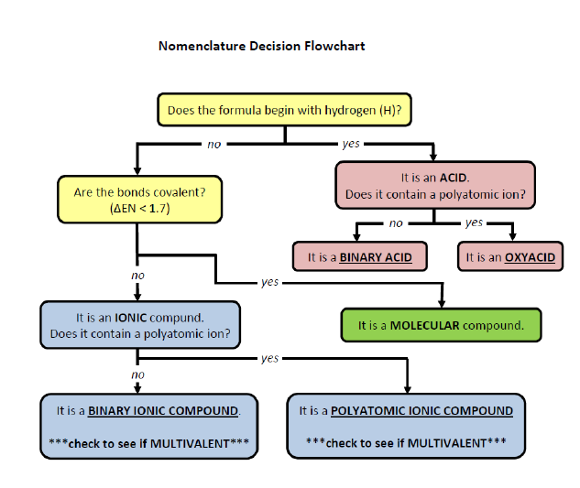

Slide 5

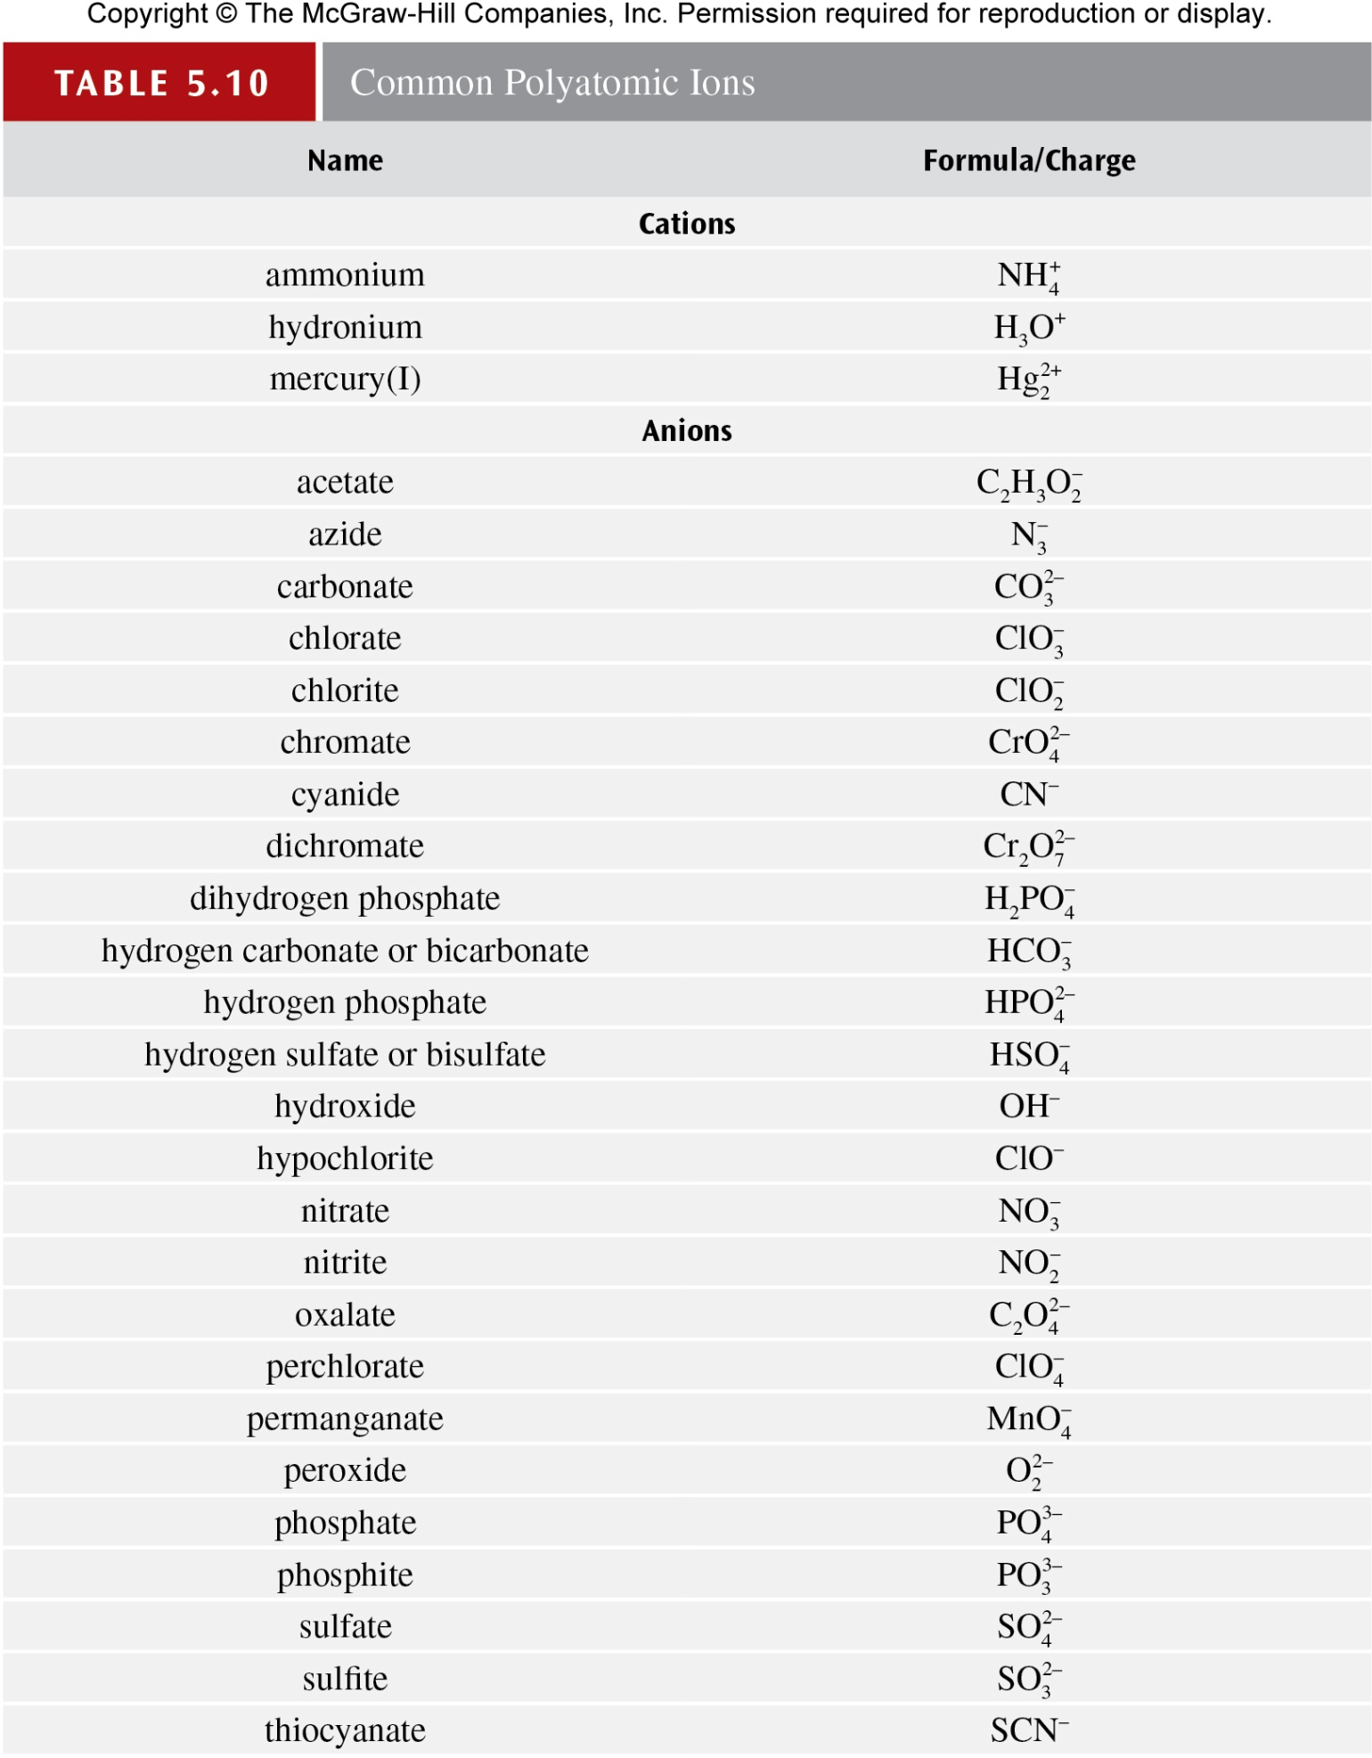
You will have access in both grade 10 and 11 to a list of common polyatomic ions for assessments, however, memorization speeds up the writing of assessments and is advisable

Slide 6

More Polyatomics!

Slide 7
The Following are Grade 11 Extensions from Grade 10! Please ensure you understand!

Slide 8
Covalent Bonding in Ionic Species - Oxyanions
Oxyanions are polyatomic anions that contain one or more oxygen atoms and one atom (the “central atom”) of another element. [note: can also be referred to as oxoanions] . Example PO₄³⁻ ion -> Central atom is Phosphorus and there are four oxygens and a charge of -3.
CLICK: Video Explanation of Naming Variations of Oxyanions.
The embedded questions in the video are NOT assessed and are to enhance your understanding only.
Notes:
Add a picture of one to show central atom.

Slide 9
Summary of Video Naming Rules (and see example on next slide)
Starting with the oxyanions that end in –ate, we can name these ions as follows :
The ion with one more O atom than the –ate ion is called the per…ate ion. Thus, ClO₃⁻ is the chlorate ion, so ClO₄⁻ is the perchlorate ion.
The ion with one less O atom than the –ate ion is called the –ite ion. Thus, ClO₂⁻ is the chlorite ion.
The ion with two fewer O atom than the –ate ion is called the hypo…ite ion. Thus, ClO⁻ is the hypochlorite ion.

Slide 10
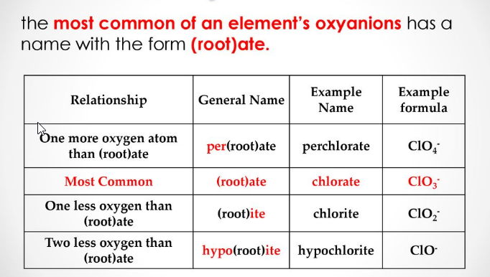
Example with the chlorate ion. You need to be able to determine the other oxyanion variations using the “-ate” ions on the periodic table chart (provided during tests)

Slide 11
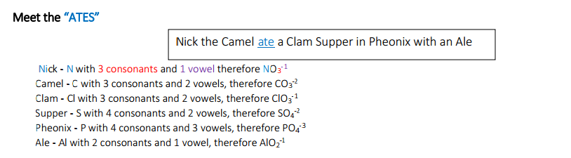
Pneumonic to help remember them!
At minimum, try to memorize the oxyanions that end in –ate so you can apply these guidelines when necessary. There is a posted pneumonic to help you or create/google your own.

Slide 12
Lets try with Na and PO₄⁻³
On your own, try forming all the variations on the phosphate ion, and naming the compound formed with sodium.

Slide 13
Side notes on Nomenclature
1. The archaic system:
ferrous (lower ion charge) vs ferric (higher charge) etc -> be able to recognize this but it will not be tested
2. Also, SOME polyatomics use prefixes in the name even though compound is ionic and/or have multiple names. Do NOT add prefixes to indicate number of ions!!

Slide 14
More examples of oxyanion groups
perchlorate ClO₄⁻
chlorate ClO₃⁻
chlorite ClO₂⁻
hypochlorite ClO⁻
nitrate NO₃⁻
nitrite NO₂⁻
phosphate PO₄³⁻
phosphite PO₃³⁻
sulfate SO₄²⁻
sulfite SO₃²⁻
See your polyatomic groups lists for other oxyanion groups

Slide 15
Put these slides in PRESENT mode for the following slides.
Attempt the question.
The yellow box will disappear to reveal the solution (possible after a hint). Compare to yours and ensure you understand any differences. Review the information in the presentation, talk to your peers and post to the FAQ (in that order) as needed.

Slide 16
Write the proper formula and give the proper name for each ionic compound formed between the two listed ions.
NH₄⁺ and S²⁻
Because the ammonium ion has a 1+ charge and the sulfide ion has a 2− charge, we need two ammonium ions to balance the charge on a single sulfide ion. Enclosing the formula for the ammonium ion in parentheses, we have (NH₄)₂S. The compound’s name is ammonium sulfide.
https://chem.libretexts.org/Courses/Los_Angeles_Trade_Technical_College/Foundations_of_Introductory_College_Chemistry/06%3A_Nomenclature/5.3_Naming_Compounds_that_contain_Polyatomic_Ions

Slide 17
Write the proper formula and give the proper name for each ionic compound formed between the two listed ions.
Al³⁺ and PO₄³⁻
Because the ions have the same magnitude of charge, we need only one of each to balance the charges. The formula is AlPO4, and the name of the compound is aluminum phosphate.

Slide 18
QUIA QUIZ CHECK-UP
NOTE: you need to sign up FIRST following these instructions
Refer to my instructions each semester on how to access this
Please Click Here to take a Quia Quiz.
INSTRUCTIONS: Please enter YOUR CORRECT NAME & Last Initial when asked. I will check the results to see how you are doing. To ensure I can best help you, take the quiz no more than twice and USE ONLY YOUR PERIODIC TABLE. This INCLUDE using the polyatomic table. You can also find this in the text book.
MAKE SURE YOU UNDERSTAND ANY ERRORS YOU MAKE. Take notes on the areas you need to pay more attention to, review the learning material, and reach out on FAQ Slides as needed.

